Slide 1

Horizon 2020 and
Data Management Plans
Sarah Jones
Digital Curation Centre, Glasgow
sarah.jones@glasgow.ac.uk
Twitter: @sjDCC
Managing Open Science workshop, EURAC, 12 January 2016, Bolzano

Slide 2

What is required by the EC under H2020?
Image CC-BY-NC-SA by Tom Magllery www.flickr.com/photos/lwr/13442910354

Slide 3
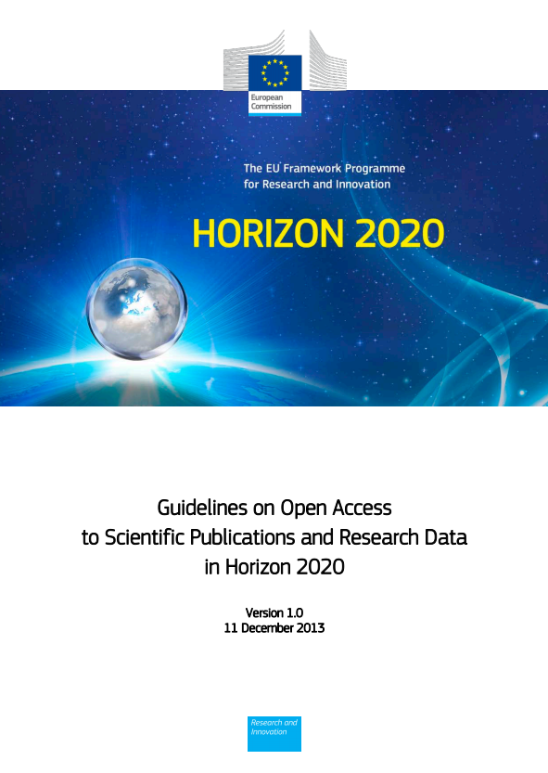
Why open access and open data?
“The European Commission’s vision is that information already paid for by the public purse should not be paid for again each time it is accessed or used, and that it should benefit European companies and citizens to the full.”
http://ec.europa.eu/research/participants/data/ ref/h2020/grants_manual/hi/oa_pilot/h2020-hi-oa-pilot-guide_en.pdf
Notes:
The background to this is about making the most of the data that has been created through publicly funded research. The guidelines speak of:
- Improved quality of results
- Greater efficiency
- Faster to market = faster growth
- Improved transparency of the scientific process
3

Slide 4
H2020 open science guidelines
Guidelines on Open Access to Scientific Publications and Research Data in Horizon 2020
  http://ec.europa.eu/research/participants/data/ref/h2020/grants_manual/hi/oa_pilot/h2020-hi-oa-pilot-guide_en.pdf
Guidelines on Data Management in Horizon 2020
  http://ec.europa.eu/research/participants/data/ref/h2020/grants_manual/hi/oa_pilot/h2020-hi-oa-data-mgt_en.pdf
Also read the specific grant agreement clauses
Notes:
4

Slide 5
Open Science in Horizon 2020
Peer-reviewed publications
Research data
Mandated to deposit machine-readable electronic copy of paper in repository by the date of publication
Ensure OA via green/gold routes
Embargo of 6 months (STEM) or 12 months (HSS) allowed
Bibliographic metadata must be made openly available
Aim to deposit research data
Pilot for projects in named areas. Other can participate voluntarily.
Applies to research data underlying publications, plus any other data as decided by project.
Participants must:
    Write a DMP as a project deliverable
    Deposit data in a repository
    Make it possible for others to access, mine, exploit and reuse the data
    Share information on the tools needed

Slide 6
Open Research Data (ORD) Pilot
Pilot focuses on research data specifically
  'Research data' refers to information, in particular facts or numbers, collected to be examined and considered and as a basis for reasoning, discussion, or calculation.
  In a research context, examples of data include statistics, results of experiments, measurements, observations resulting from fieldwork, survey results, interview recordings and images. The focus is on research data that is available in digital form.
Guidelines on Open Access to Scientific Publications and Research Data in Horizon 2020 v.2.0, 30 October 2015, p3

Slide 7
H2020 areas participating in the pilot
Future and Emerging Technologies
Research infrastructures (new: coverage of the whole area)
Leadership in enabling and industrial technologies – Information and Communication Technologies
Nanotechnologies, Advanced Materials, Advanced Manufacturing and Processing, and Biotechnology: ‘nanosafety’ and ‘modelling’ topics (new)
Societal Challenge: Food security, sustainable agriculture and forestry, marine and maritime and inland water research and the bioeconomy - selected topics as specified in the work programme (new)
Societal Challenge: 'Climate Action, Environment, Resource Efficiency and Raw materials' – except raw materials
Societal Challenge: 'Europe in a changing world – inclusive, innovative and reflective Societies'
Science with and for Society
  Cross-cutting activities - focus areas – part Smart and Sustainable Cities (moved from Energy WP)
Projects in other areas can participate on a voluntary basis
Notes:
There are seven areas participating in the pilot. This corresponds to about €3 billion or 20% of the overall Horizon 2020 budget in 2014 and 2015.
Projects in others can take part on a voluntary basis. It’s an opt in / opt out basis.
7

Slide 8
Exemptions – reasons for opting out
If results are expected to be commercially or industrially exploited
If participation is incompatible with the need for confidentiality in connection with security issues
Incompatible with existing rules on the protection of personal data
Would jeopardise the achievement of the main aim of the action
If the project will not generate / collect any research data
If there are other legitimate reasons to not take part in the Pilot
Can opt out at proposal stage OR during lifetime of project
Should describe issues in the project Data Management Plan
Notes:
Projects in these seven areas aren’t forced to participate. There are various reasons to opt out e.g. if results can’t be shared due to confidentiality, legal restrictions or commercial opportunities.
Opt out is available at any point. It can also apply to certain parts of the data e.g. they could share some aspects but not others.
8

Slide 9

  Approach:
  as open as possible, as closed as necessary
Image: ‘Balancing rocks’ by Viewminder CC-BY-SA-ND www.flickr.com/photos/light_seeker/7780857224

Slide 10
Which data does the pilot apply to?
Data, including associated metadata, needed to validate the results in scientific publications
Other curated and/or raw data, including associated metadata, as specified in the DMP
Doesn’t apply to all data (researchers to define as appropriate)
Don’t have to share data if inappropriate – exemptions apply
Notes:
For those that do take part in the pilot, the starting point is to make all data that underpin publications open. After that, it’s for researchers to define what else should be shared and can be made open. This should be outlined in the DMP.
Sometimes sharing is not appropriate (e.g. due to ethical rules of personal data, intellectual property protection, commercial restrictions etc). It’s fine to apply restrictions in such cases. This could be an embargo period prior to publication or while a patent is sought, or controlling access and re-use to protect participants’ identities (e.g. via the use of secure data services / data enclaves or data sharing agreements). Restrictions should be outlined up-front in the DMP.
10

Slide 11
Key requirements of the open data pilot
Beneficiaries participating in the Pilot will:
  Deposit data in a research data repository of their choice
  Take measures to make it possible for others to access, mine, exploit, reproduce and disseminate the data free of charge
  Provide information about tools and instruments necessary for validating the results (where possible, provide the tools and instruments themselves)
Notes:
So the specific requirements on projects that participate in the pilot are to:
- Deposit data in a repository
Enable reuse via open licensing
Provide any tools (or at least info on them) needed to validate the data
The focus is planning for data sharing and then facilitating that through deposit, licensing and enabling reproducibility
11

Slide 12
Data Management Plans
Projects participating in the pilot will be required to develop a Data Management plan (DMP), in which they will specify what data will be open.
Note that the Commission does NOT require applicants to submit a DMP at the proposal stage.
A DMP is therefore NOT part of the evaluation.
DMPs are a deliverable for those participating in the pilot.
Notes:
12

Slide 13
What is a data management plan?
A brief plan written at the start of a project to define:
how the data will be created?
how it will be documented?
who will access it?
where it will be stored?
who will back it up?
whether (and how) it will be shared & preserved?
DMPs are often submitted as part of grant applications, but are useful whenever researchers are creating data.

Slide 14
How do DMPs help?
Planning is useful whether or not a DMP needs submitted with a grant application, as it can help you to…
  Make informed decisions to anticipate and avoid problems
  Avoid duplication, data loss and security breaches
  Develop procedures for consistency across teams / sites
  Ensure data are accurate, complete, reliable and secure
  Save time and effort to make your life easier!

Slide 15
Info on RDM: what and when
PROPOSAL STAGE
IN PROJECT
Where relevant*, H2020 proposals can include a section on data management which is evaluated under the criterion ‘Impact’
What types of data will the project generate/collect?
What standards will be used?
How will this data be shared/made available? If not, why?
How will this data be curated and preserved?
* For “Research and Innovation actions” and “Innovation Actions”
DMPs are a project deliverable for those participating in the open data pilot.
Not a fixed document – should evolve and gain precision
  Deliver first version within initial 6 months of project
  More elaborate versions whenever important changes to the project occur. At least at the mid-term and final review.
Notes:
Although DMPs are a project deliverable and not required at the application stage, proposals can include a section on data management if desired. The info suggested here is similar to the preliminary DMP, so essentially gets that started.
15

Slide 16

How to comply with EC ORD pilot expectations
Image under licence to DCC

Slide 17
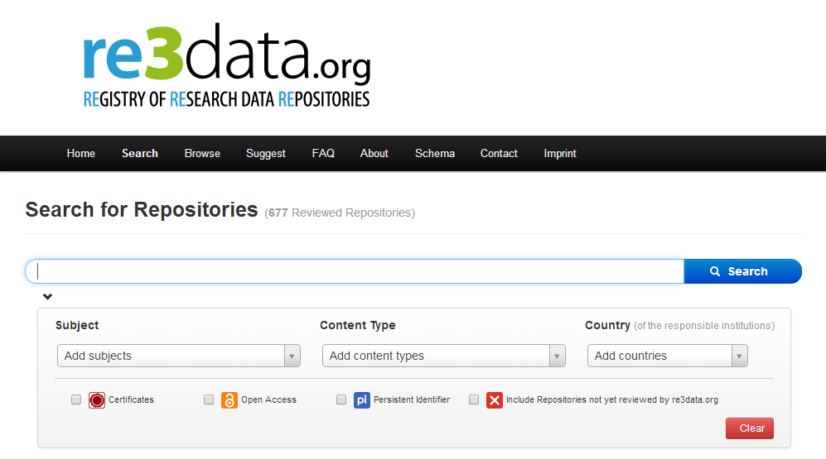
Deposit in a data repository
Does your publisher or funder suggest a repository?
Are there data centres or community databases for your discipline?
Does your university offer support for long-term preservation?
Zenodo
OpenAIRE-CERN joint effort
Multidisciplinary repository
Multiple data types
    Publications
    Long tail of research data
Citable data (DOI)
Links funding, publications, data & software
www.zenodo.org
http://databib.org
http://service.re3data.org/search
Notes:
17

Slide 18
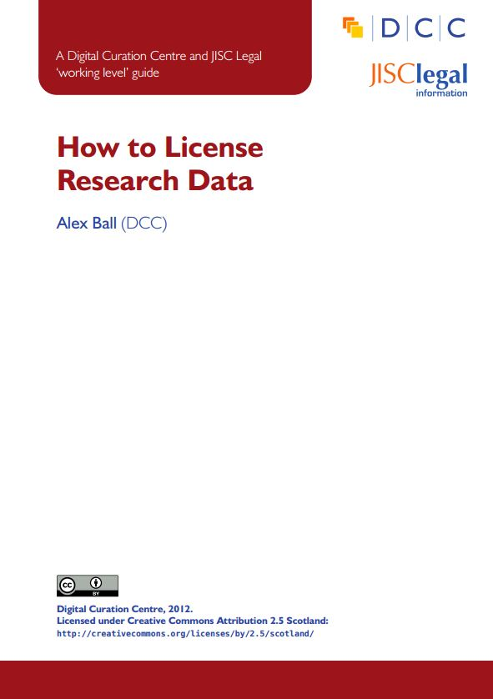




License research data openly
This DCC guide outlines the pros and cons of each approach and gives practical advice on how to implement your licence
CREATIVE COMMONS LIMITATIONS
NC Non-Commercial
What counts as commercial?
ND No Derivatives
Severely restricts use
These clauses are not open licenses
Horizon 2020 Open Access guidelines point to:
or
www.dcc.ac.uk/resources/how-guides/license-research-data
Notes:
Guidance from the DCC can also help researchers to understand data licensing. This guide outlines the pros and cons of each approach e.g. the limitations of some CC options
The OA guidelines under Horizon 2020 point to CC-0 or CC-BY as a straightforward and effective way to make it possible for others to mine, exploit and reproduce the data. See p11 at: http://ec.europa.eu/research/participants/data/ref/h2020/grants_manual/hi/oa_pilot/h2020-hi-oa-pilot-guide_en.pdf
18

Slide 19


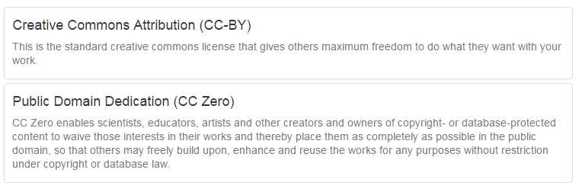
EUDAT licensing tool
Answer questions to determine which licence(s) are appropriate to use
http://ufal.github.io/lindat-license-selector

Slide 20
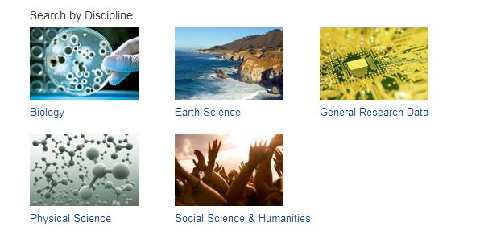

Provide metadata and documentation
Use relevant standards for interoperability
www.dcc.ac.uk/resources/metadata-standards
Notes:
To make sure their data can be understood by themselves, their community and others, researchers should create metadata and documentation.
Metadata is basic descriptive information to help identify and understand the structure of the data e.g. title, author...
Documentation provides the wider context. It’s useful to share the methodology / workflow, software and any information needed to understand the data e.g. explanation of abbreviations or acronyms
There are lots of standards that can be used. The DCC started a catalogue of disciplinary metadata standards which is now being taken forward as an international initiative via an RDA working group
20

Slide 21
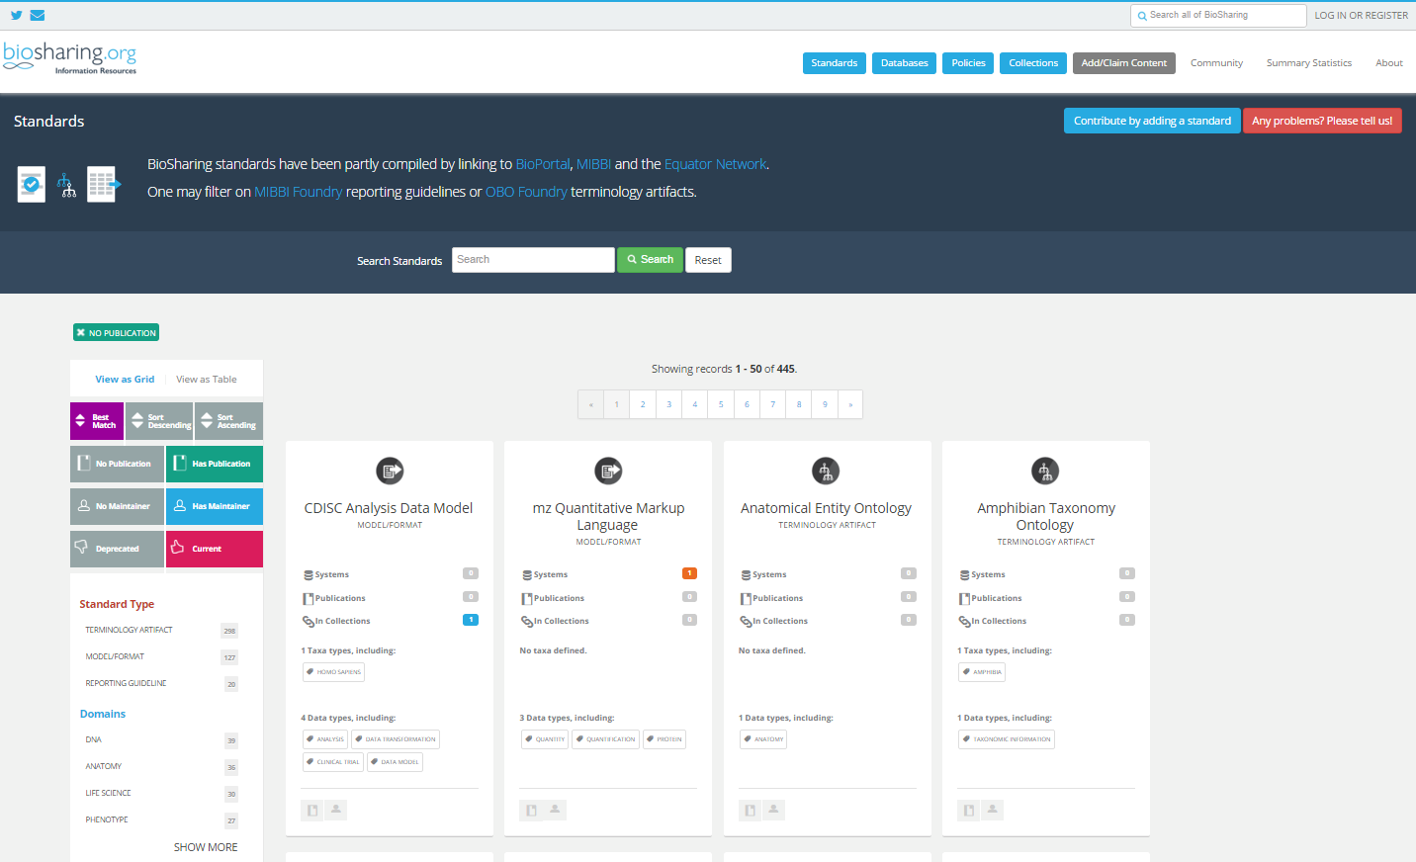
Biosharing
Information on standards, databases and ontologies for the Life Sciences
https://biosharing.org

Slide 22
Choosing appropriate file formats
If you want your data to be re-used and sustainable in the long-term, you typically want to opt for open, non-proprietary formats.
Type | Recommended | Avoid for data sharing
Tabular data | CSV, TSV, SPSS portable | Excel
Text | Plain text, HTML, RTF PDF/A only if layout matters | Word
Media | Container: MP4, Ogg Codec: Theora, Dirac, FLAC | Quicktime H264
Images | TIFF, JPEG2000, PNG | GIF, JPG
Structured data | XML, RDF | RDBMS
Further examples for the social sciences:
www.data-archive.ac.uk/create-manage/format/formats-table

Slide 23

How to make data open?
Choose your dataset(s)
  What can you may open? You may need to revisit this step if you encounter problems later.
Apply an open license
  Determine what IP exists. Apply a suitable licence e.g. CC-BY
Make the data available
  Provide the data in a suitable format. Use repositories.
Make it discoverable
  Post on the web, register in catalogues…
https://okfn.org

Slide 24
Plan for openness from the outset
Many decisions taken early on in the project will affect whether the data can be made openly available
Think about where you want to publish and include APCs in grant applications if needed
Ensure consent agreements also include permission to archive and share data for reuse by others
Seek permissions for more than just the primary project purpose if signing licences to reuse third-party data. Derivative data may not be able to be shared if it includes somebody else’s IP
Explore the potential for openness when drafting agreements with commercial partners

Slide 25
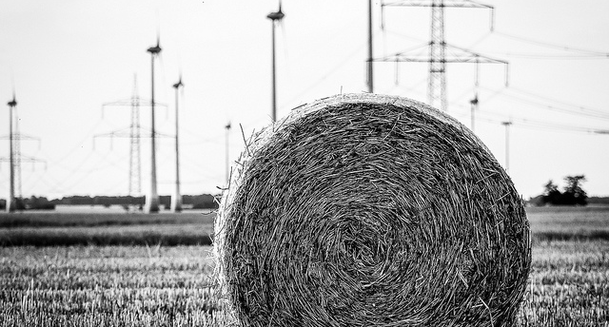
Useful resources
Image ‘Energy Resources | Energie Quelle’ CC-BY-NC by K. H. Reichert www.flickr.com/photos/reupa/19502634575

Slide 26
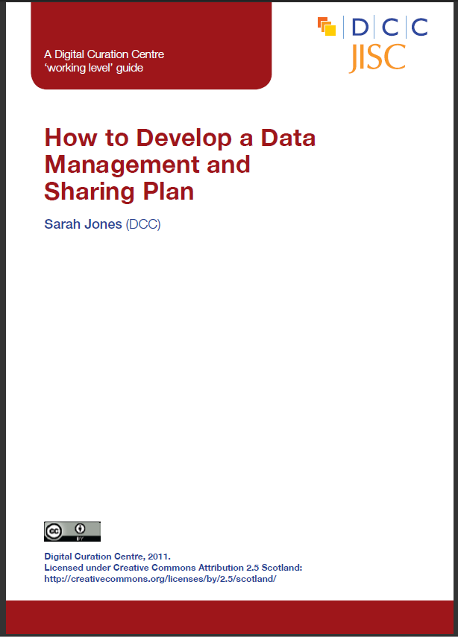
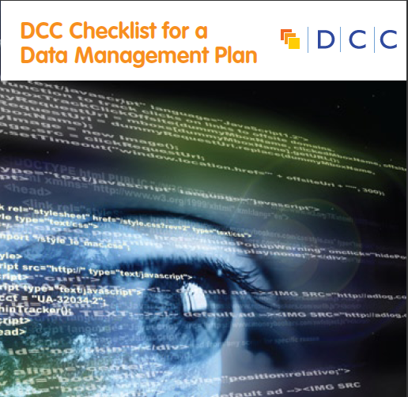

DCC support on DMPs
Webinars and training materials
How-to guides and other advisory documents
Checklist on what to cover in DMPs
Example DMPs
DMPonline
www.dcc.ac.uk/resources/data-management-plans

Slide 27
Example plans
108 DMPs from the National Endowment for the Humanities (USA)
www.neh.gov/divisions/odh/grant-news/data-management-plans-successful-grant-applications-2011-2014-now-available
20+ scientific DMPs submitted to the NSF (USA) provided by UCSD
http://libraries.ucsd.edu/services/data-curation/data-management/dmp-samples.html
2 Rural Economy & Land Use (RELU) programme examples (UK)
http://relu.data-archive.ac.uk/data-sharing/planning/examples
Further examples:
  www.dcc.ac.uk/resources/data-management-plans/guidance-examples

Slide 28
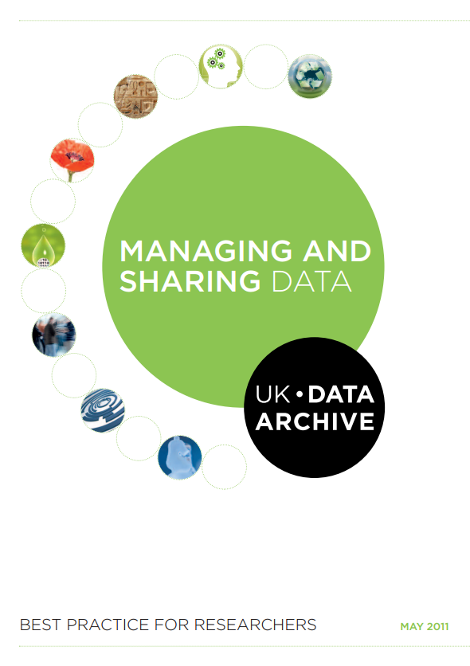
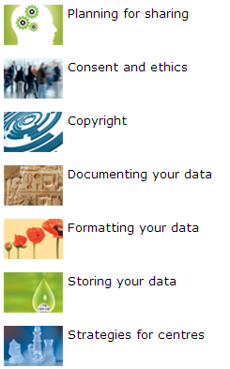
Managing and sharing data: a best practice guide
http://data-archive.ac.uk/media/2894/managingsharing.pdf

Slide 29




Ongoing coordination and support actions (FP7 funded)

Slide 30
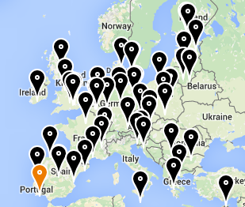
FOSTER
Facilitate Open Science Training for European Research
Network of open access trainers
Programme of open science courses
Portal to training materials
E-learning courses on open access, open data and open science forthcoming
www.fosteropenscience.eu

Slide 31
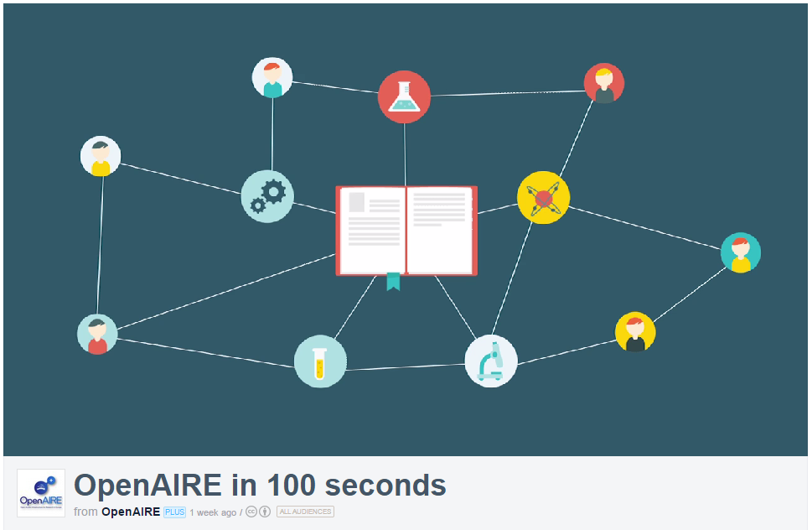
OpenAIRE
Open Access Infrastructure for research in Europe
aggregates data on OA publications
mines & enriches it content by linking thing together
provides services & APIs e.g.
to generate publication lists
  www.openaire.eu
http://vimeo.com/108790101
Notes:
OpenAIRE is also worth checking out. This is an EC-funded project to provide infrastructure for open access. They’ve recently released a short video that tells you how they can help.
Essentially OpenAIRE aggregates metadata from different repositories to compile a complete list of publications and related outputs. They mine and enrich the content, de-duplicating entries and linking together publications with data, details about the project, authors, funders etc. OpenAIRE also provides a number of useful services & APIs, for example you can embed a publication list for your project in your website that is automatically updated whenever someone adds a new paper to a repository (this is harvested into OpenAIRE and pushed out to your list).

Slide 32
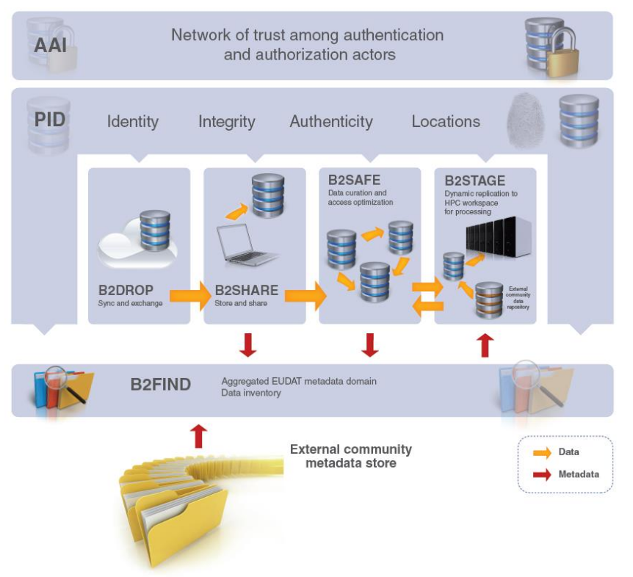

EUDAT services
EUDAT offers a pan-European solution, providing a generic set of services to ensure minimum level of interoperability
Building common data services in close collaboration with 25+ communities
www.eudat.eu
Notes:
All share common challenges:
– Reference models and architectures
– Persistent data identifiers
– Metadata management
– Distributed data sources
– Data interoperability

Slide 33
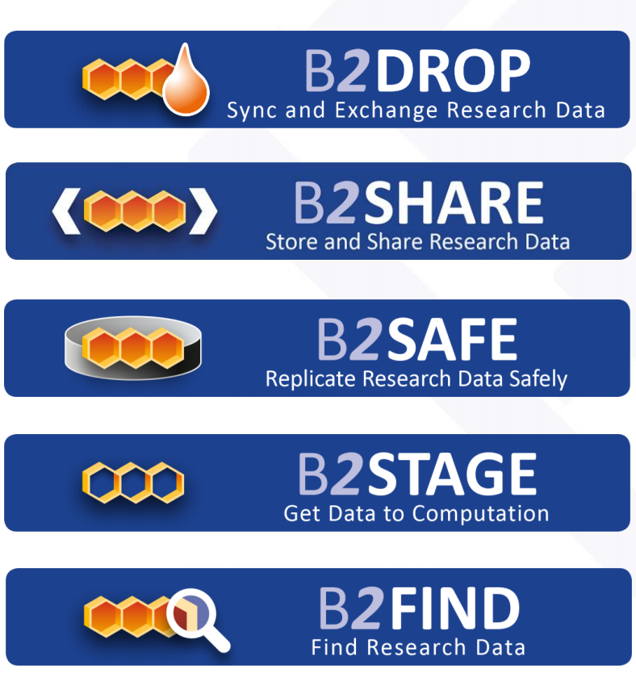
EUDAT B2 service suite
Covering both access and deposit, from informal data sharing to long-term archiving, and addressing
identification, discoverability and computability of both long-tail and big data, EUDAT’s services will address the full lifecycle of research data

Slide 34











Discipline-specific infrastructure
Arts & Humanities
databank on health, ageing and retirement
Clinical research
Language research
Oceanography
Biological and life sciences
Translational medicine
Astronomy e-VLBI network
Materials science
Biological resources
Social science

Slide 35

Thanks for listening
DCC resources on Data Management Plans:
www.dcc.ac.uk/resources/data-management-plans
Follow us on twitter:
@digitalcuration and #ukdcc

